Slide 1

Service On Wheels
→ You Report! We Fix

Slide 2

INTRODUCTION
Innovative web app to streamline vehicle breakdowns. Providing on wheel roadside assistance with real-time updates and user- friendly interface. Enhancing customer experience and efﬁciency in handling breakdowns.

Slide 3

PROBLEM IDENTIFICATION & PROPOSAL
Addressing the gap between a stranded vehicle and a reliable mechanic, Service on Wheels introduces key features to streamline assistance. Our innovative Vehicle Problem Diagnostic guides users in troubleshooting.
The GPS tracking system identifies nearby mechanic shops, ensuring swift access to services.
Immediate slot booking provides convenience, while our user-friendly interface enhances accessibility.
With these special features, we bridge the gap, offering prompt and efficient solutions for on-the-road breakdowns.

Slide 4
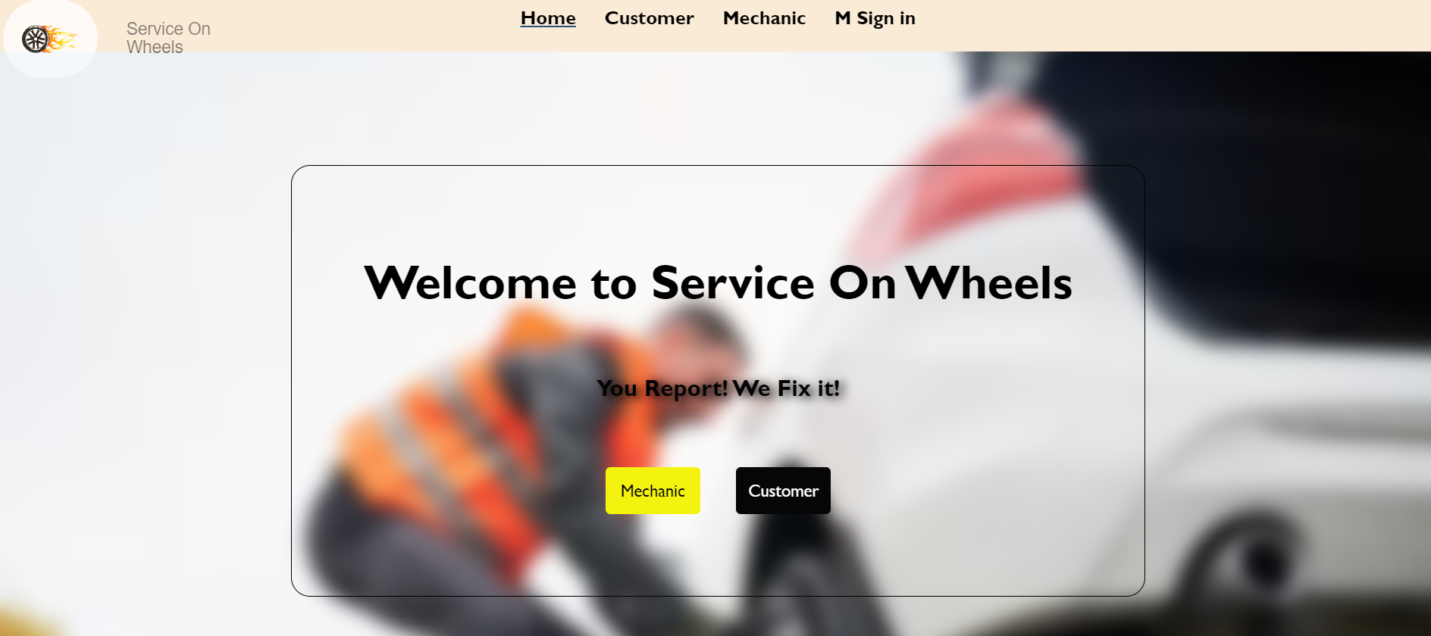
USER-FRIENDLY INTERFACE
Intuitive design for easy navigation and quick request submission. Customizable user proﬁles for personalized assistance and seamless experience.

Slide 5
User Portal
Vehicle diagnosis questions:
Is any warning light on the dashboard?
Can you describe unusual sounds from vehicle?
Check if there is enough fuel in the tank, Is the fuel gauge showing a sufficient level?
Have you noticed any leakage under the vehicle?
...etc

Slide 6
GPS & Slot Booking:
GPS Tracking System: The system employs GPS technology to pinpoint the location of the stranded vehicle and identifies nearby mechanic shops, facilitating quick access to repair services.
Immediate Slot Booking: Users can seamlessly book service slots, ensuring prompt assistance. This feature adds convenience and minimizes downtime for drivers experiencing vehicle breakdowns.

Slide 7
Mechanic Portal:
In the mechanic portal, mechanics register and log in to view and respond to service bookings.
They can accept or reject bookings based on their availability.
Upon acceptance, an immediate call connects the mechanic with the customer, facilitating quick issue resolution as the mechanic heads to the customer's location.

Slide 8

FUTURE DEVELOPMENT
Diagnostic part of Project is the addressable and important module, now implemented in web application will be implemented with Artificial Intelligence in further. This integration will enhance the accuracy of vehicle troubleshooting through the application of Artificial Intelligence.

Slide 9
CONCLUSION
The innovative web app has revolutionized the roadside assistance industry, providing real-time updates, user-friendly interface, and efﬁcient dispatch system. With integrated payment solutions and enhanced customer experience, the future development aims to further improve vehicle breakdown support.

